Slide 1

WELCOM TO ABC LAUNDRY ONLINE COMPANY
WE ARE DEVELOPERS
TUẤN- LÂM – THẠCH – MINH

Slide 2
WELCOM TO ABC LAUNDRY ONLINE WEBAPP
THE MAIN CONTENT OF THIS PROJECT HERE

Slide 3
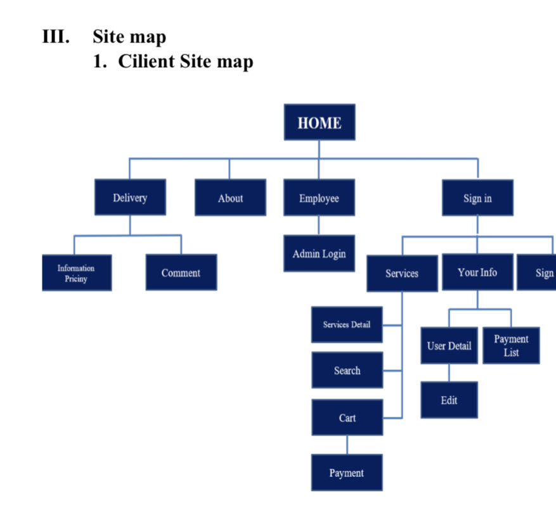
THE MAIN UTILITIES FOR USER, THAT HAVE TO GARANTEE
WEB SPRING BOOT API

Slide 4
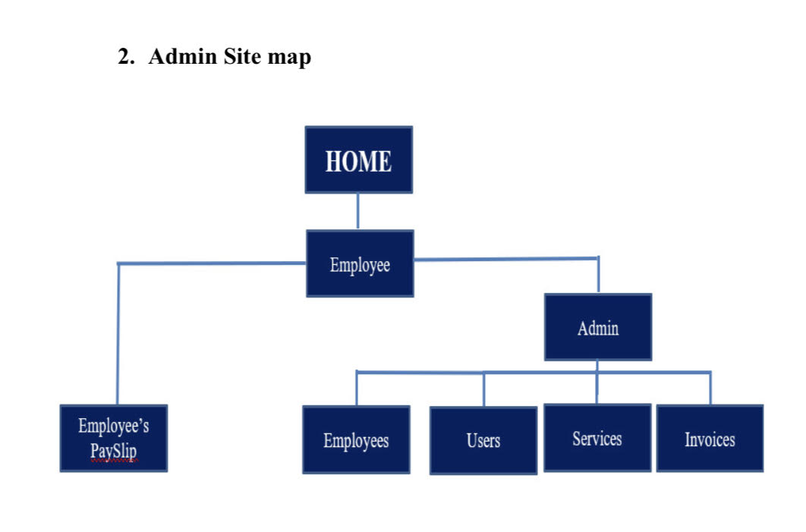
THE MAIN UTILITIES FOR EMPLOYEE, THAT HAVE TO GARANTEE
WEB SPRING BOOT API

Slide 5
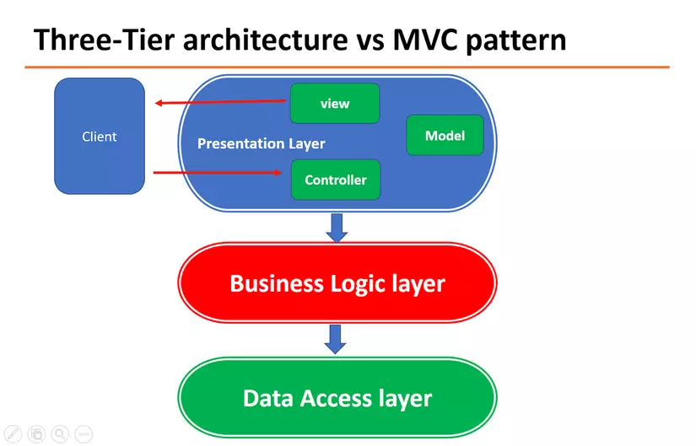
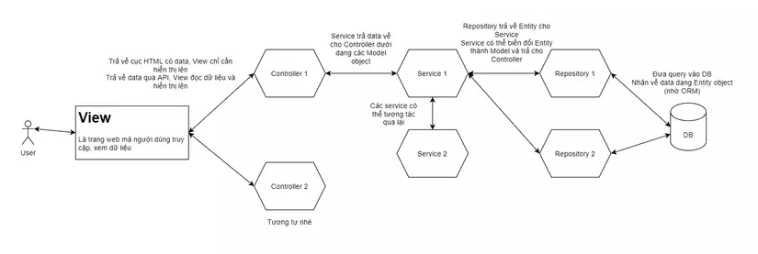
HOW WE HANDLE THIS REQUEST FROM TECHNIC FRAMEWORK
Aiming to create an effective management tool for company leaders and the fastest and most convenient means of information transmission for employees, the Company has a program of parallel development of Website and Webapp on the basis of programming language. modern and popular today: Spring boot framework; Smartphones with Android and iOS operating systems. Website is used for internal management of the company, Web app is used for employees to look up payroll and some other useful information. Through testing time, the main interface may look like this:

Slide 6
PROJECT DESIGN
REVIEW 2

Slide 7
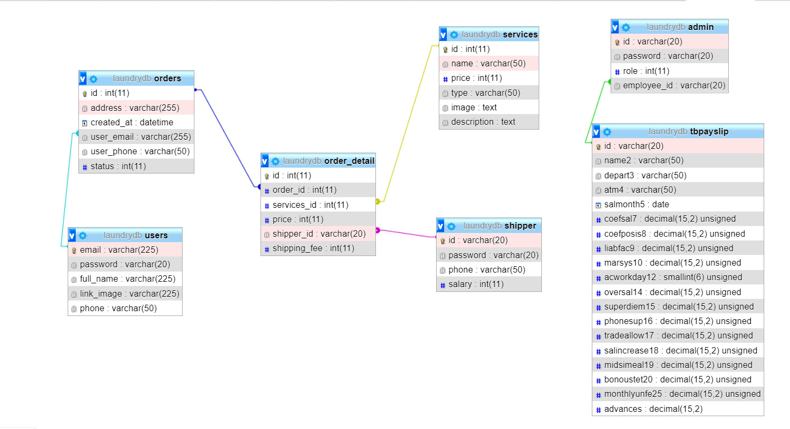
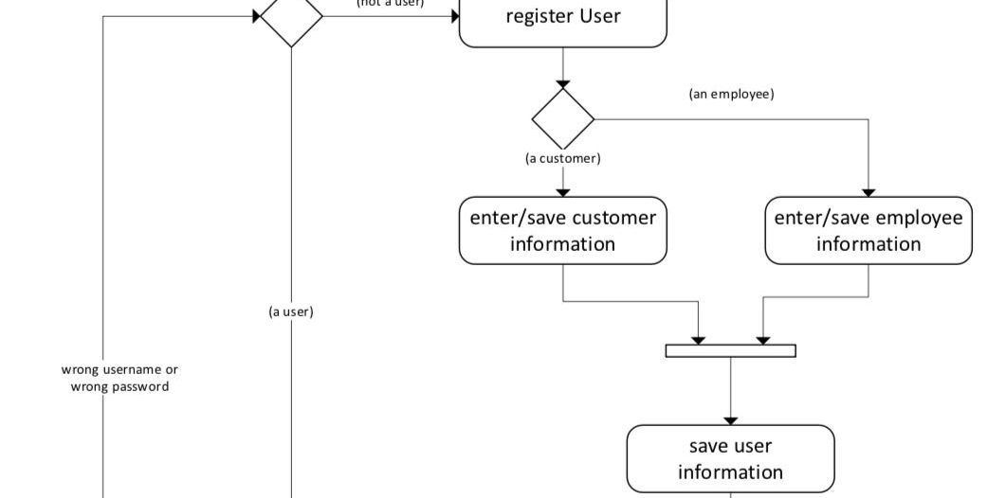
PROJECT DESIGN
REVIEW 2

Slide 8

SCREEN SHOT HOME

Slide 9

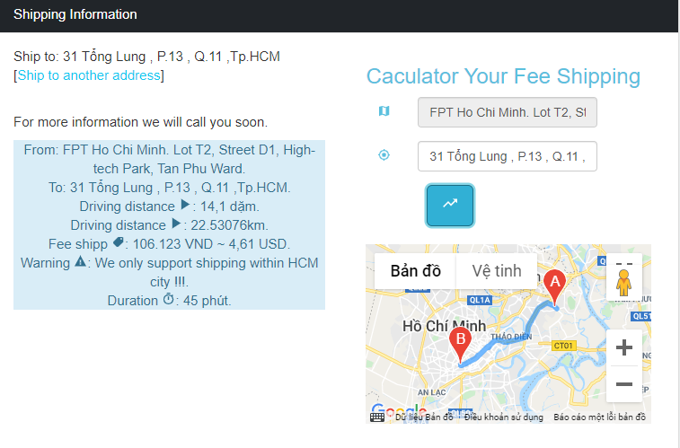
SCREEN SHOT DELIVERY

Slide 10
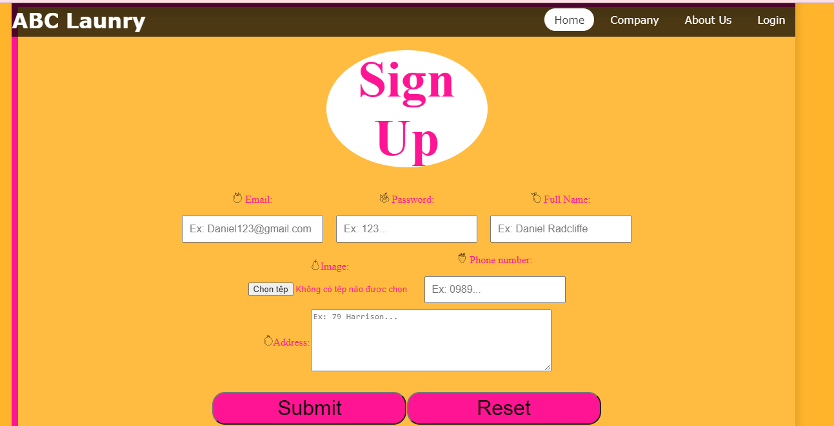

SCREEN SHOT SIGN IN

Slide 11
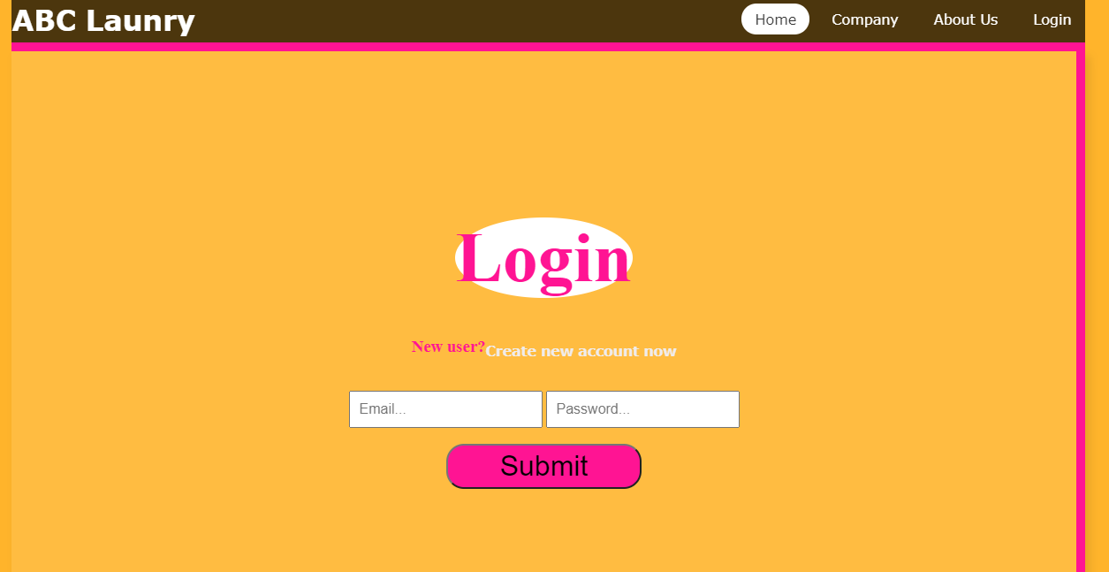

SCREEN SHOT SIGN OUT

Slide 12
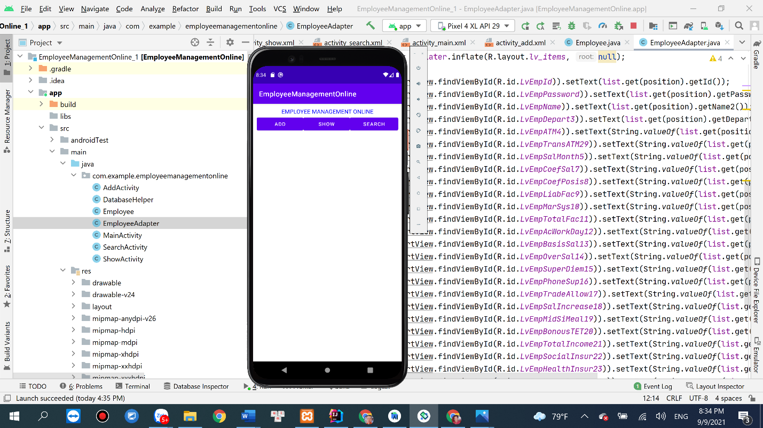
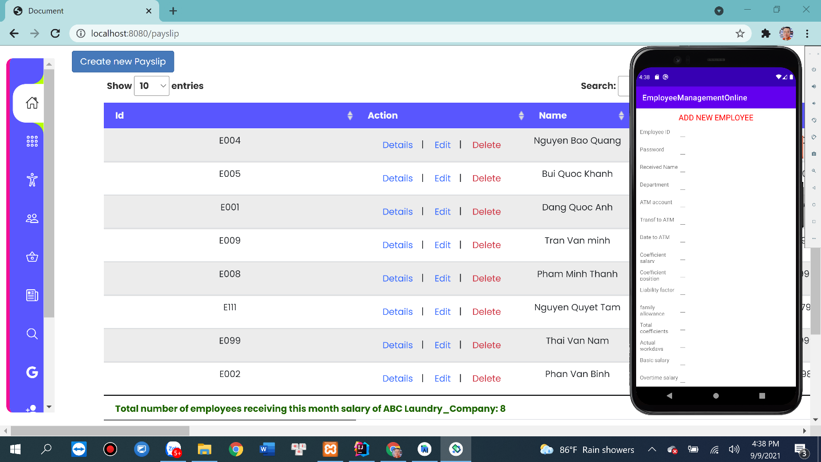
SCREEN SHOT EMPLOYEE

Slide 13
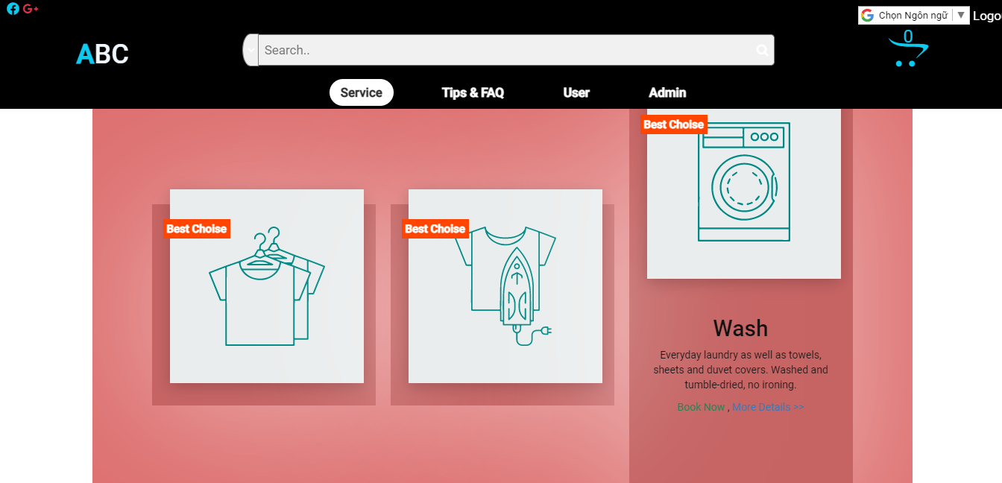
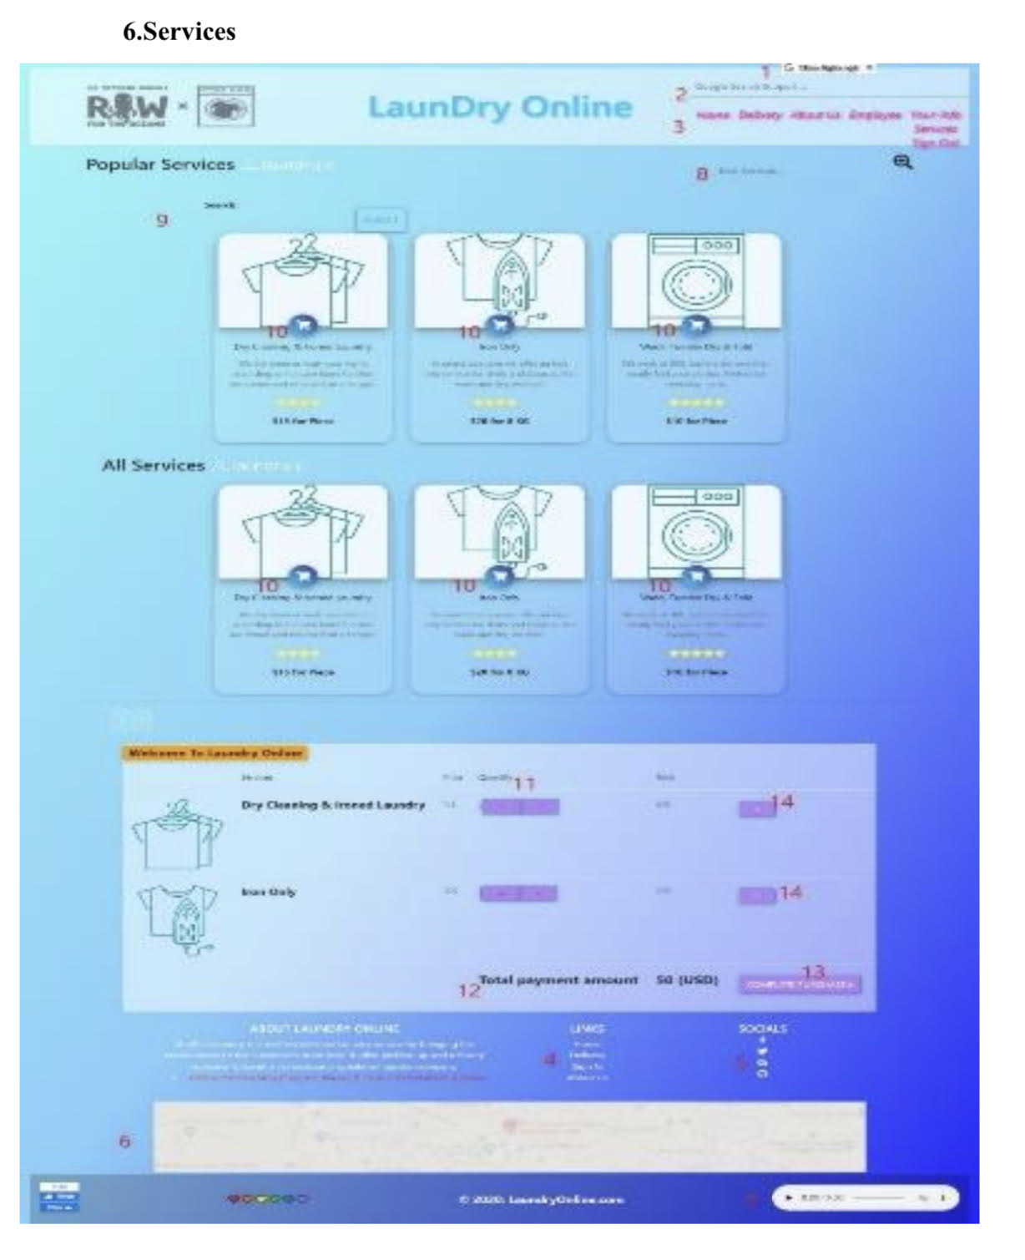
SCREEN SHOT SERVICES

Slide 14
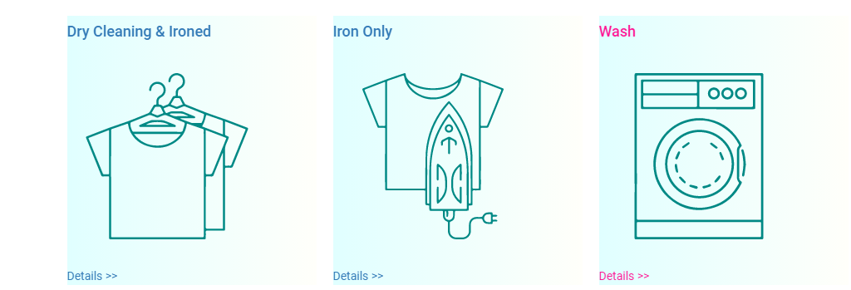
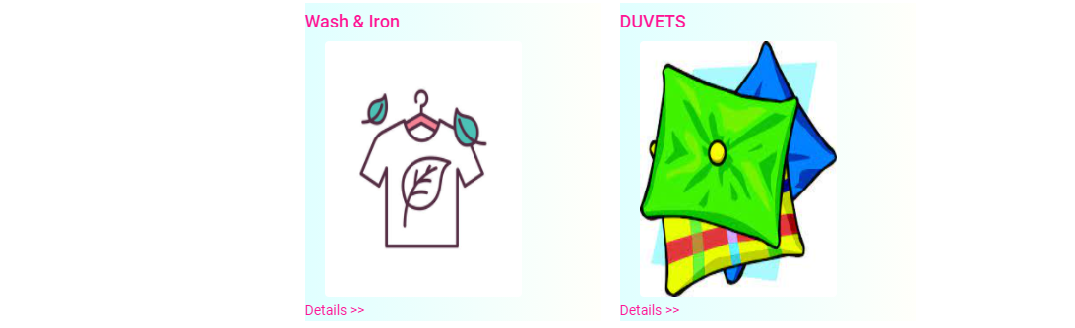
SCREEN SHOT SERVICES

Slide 15

SCREEN SHOT SERVICES

Slide 16

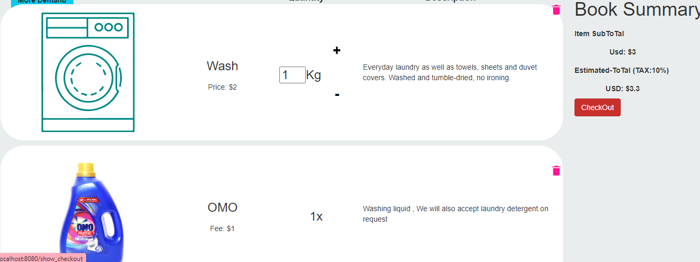
SCREEN SHOT PAYMENT

Slide 17
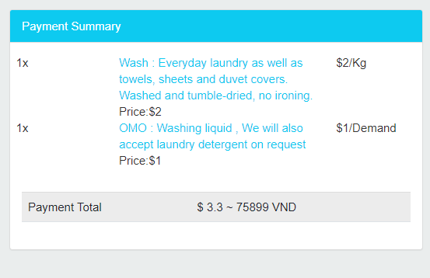
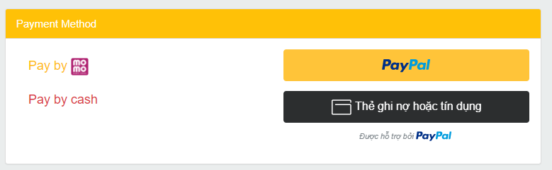

Slide 18

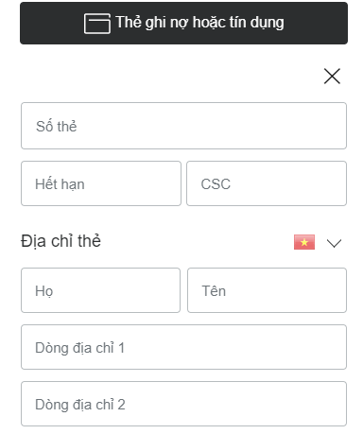
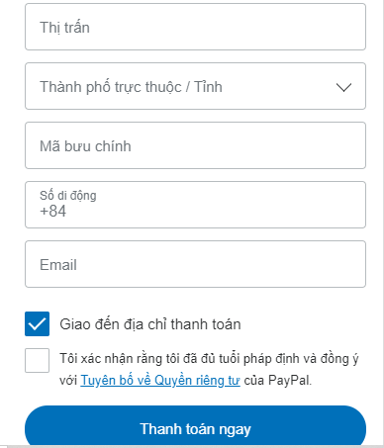
SCREEN SHOT PAYMENT_CREATE PAYPAL ACCOUNT

Slide 19
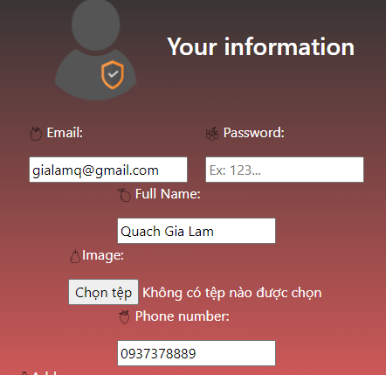
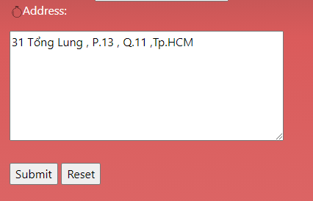
SCREEN SHOT YOUR_INFOR

Slide 20
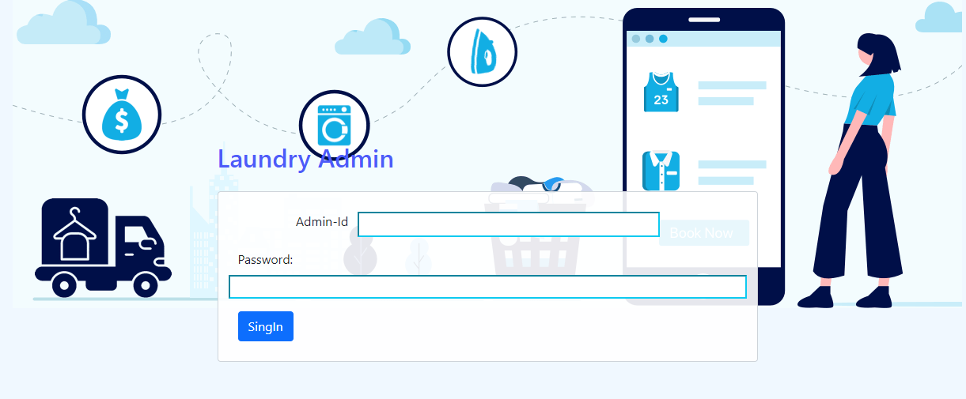
SCREEN SHOT HOME

Slide 21
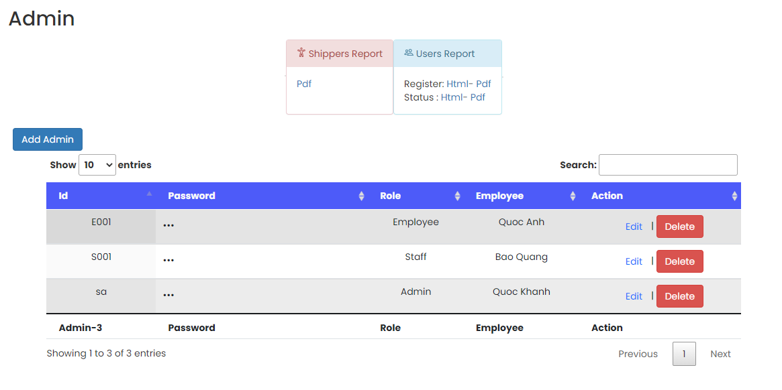

SCREEN SHOT ADMIN PAGE

Slide 22
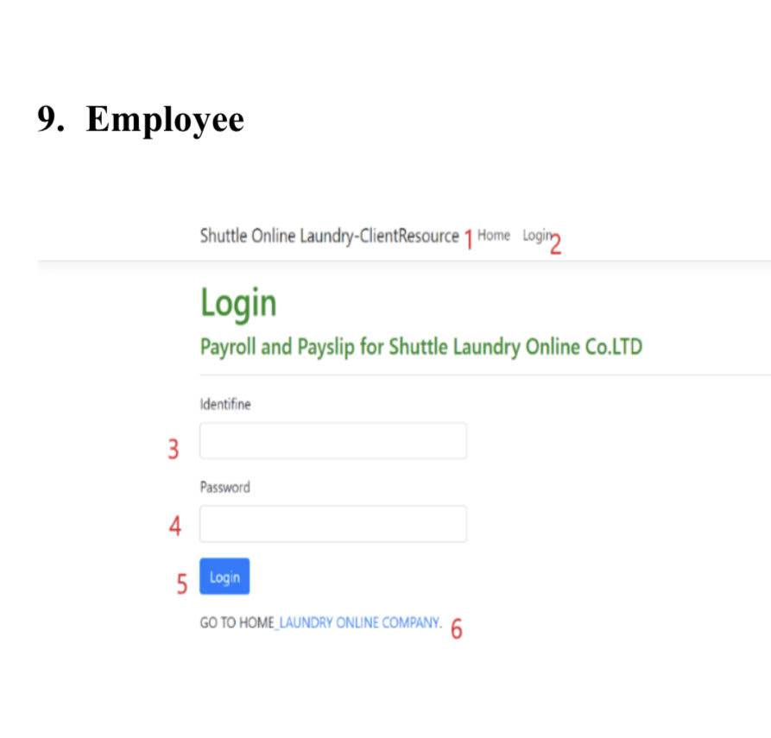
SCREEN EMPLOYEE

Slide 23
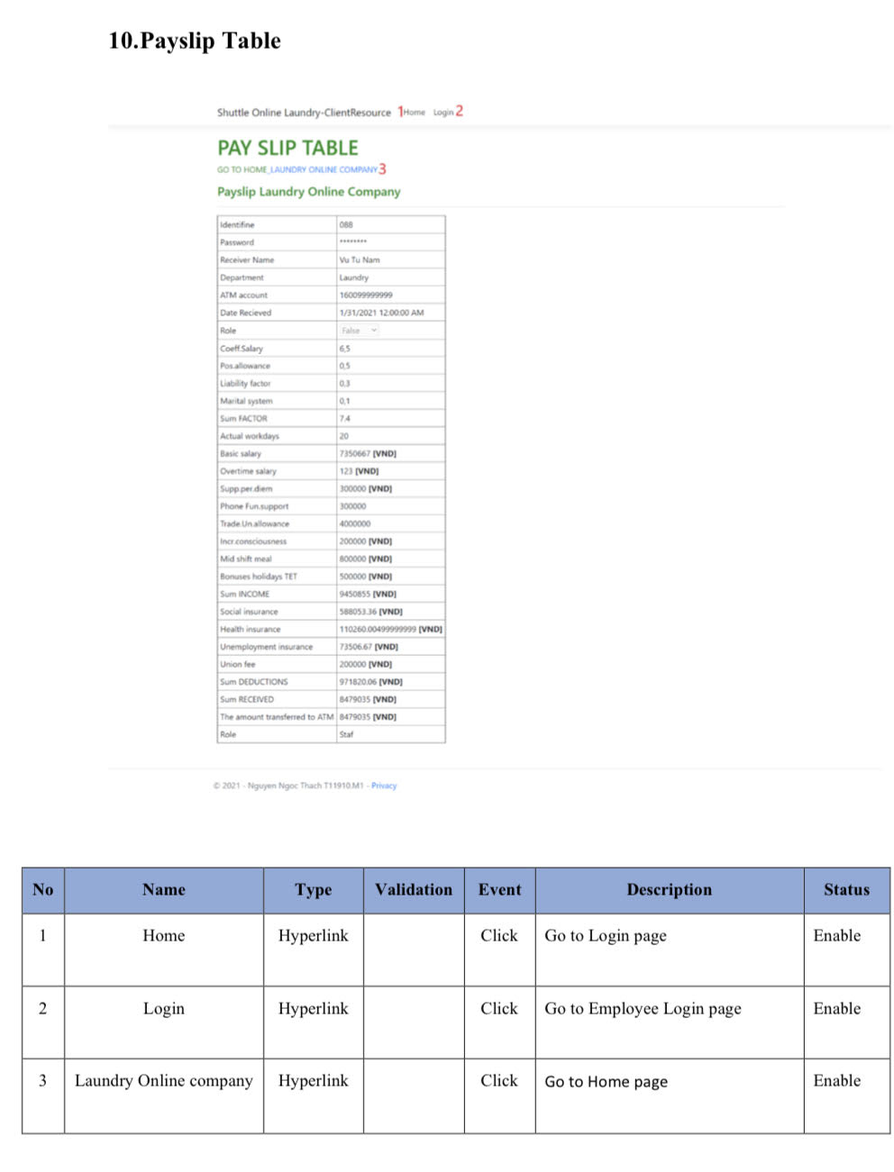
SCREEN SHOT PAYSLIP TABLE

Slide 24
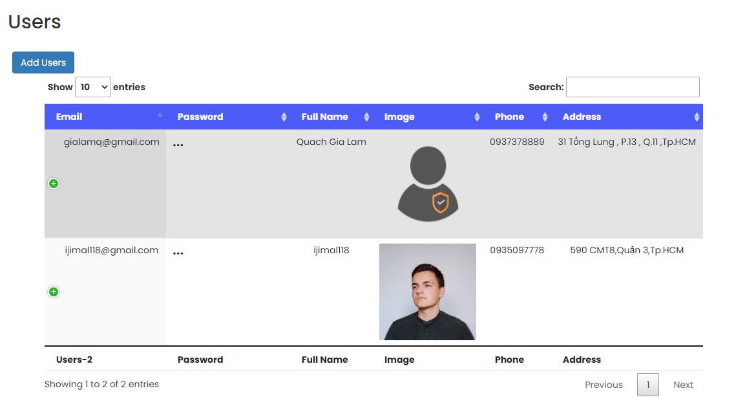
SCREEN SHOT CUSTOMERS(USERS)

Slide 25
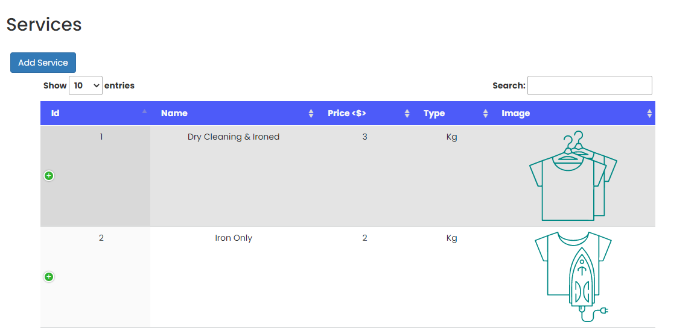

SCREEN SHOT INVOICES

Slide 26
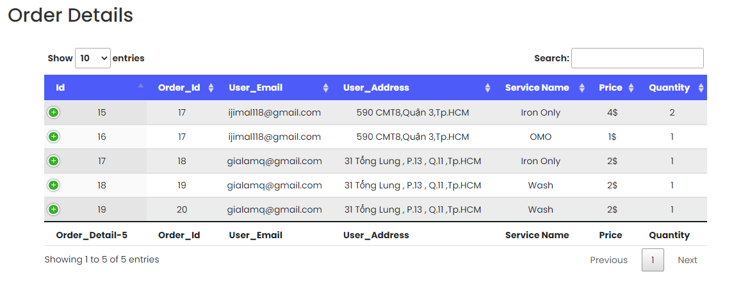
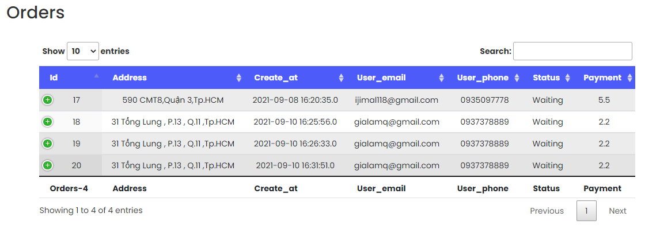
SCREEN SHOT SERVICE DETAILS

Slide 27
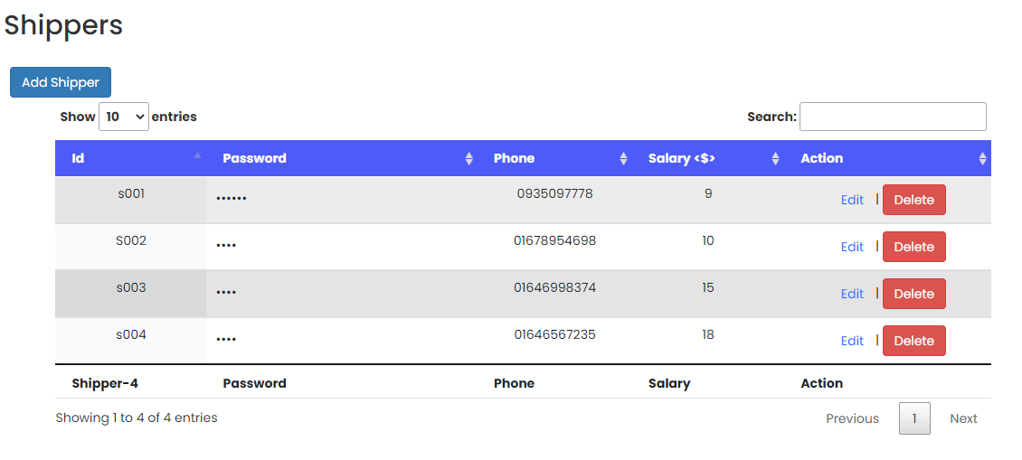
SCREEN SHOT GUIDE FOR DEVELOPER

Slide 28
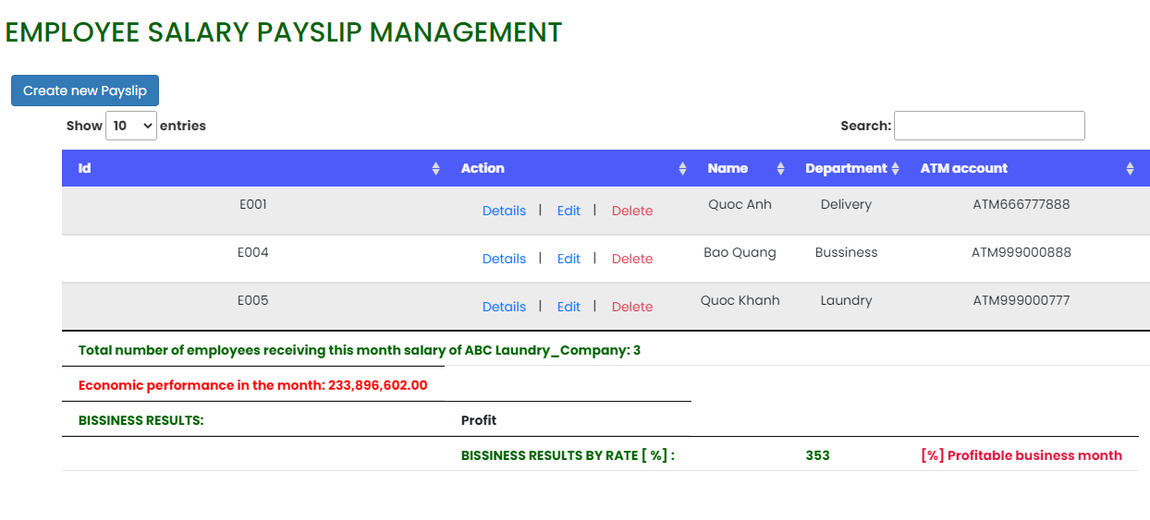
SCREEN SHOT GUIDE FOR DEVELOPER

Slide 29
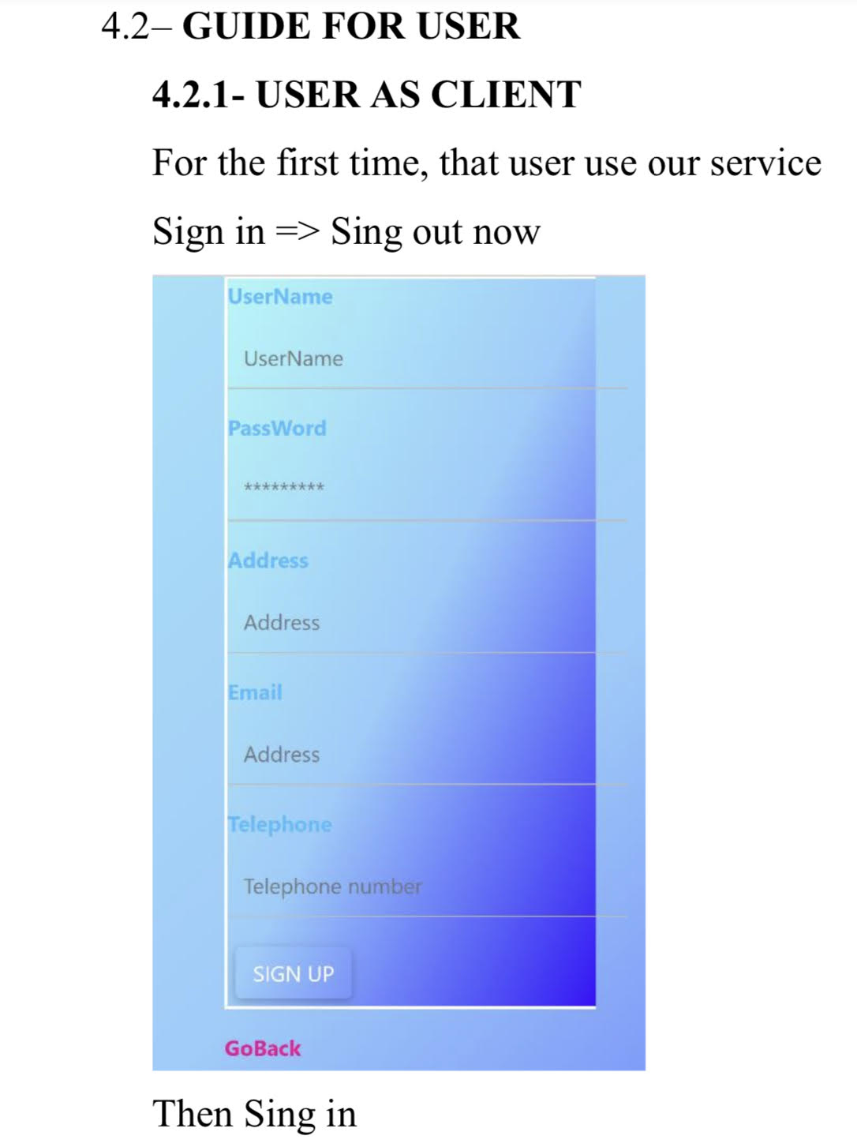
SCREEN SHOT GUIDE FOR USER FIRST TIME TO USE APP

Slide 30
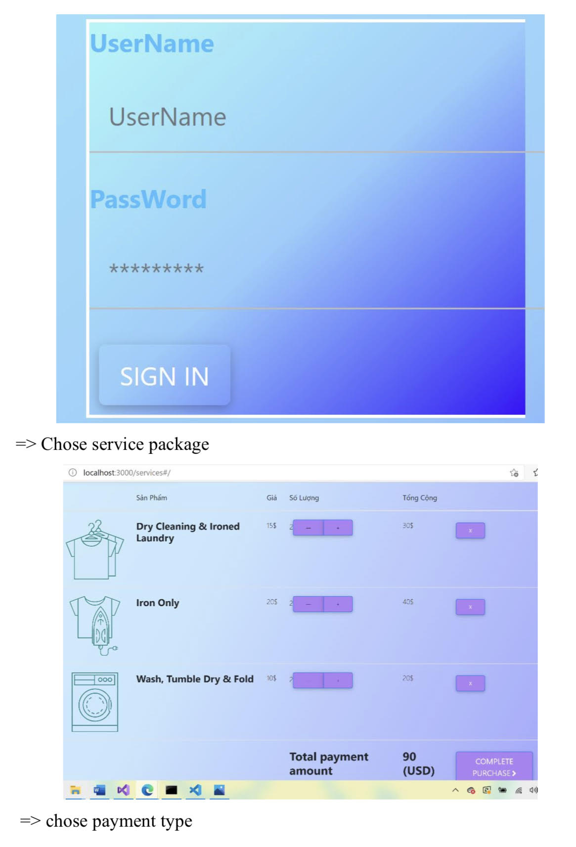
SCREEN SHOT GUIDE FOR USER AFTER LOG OUT APP

Slide 31
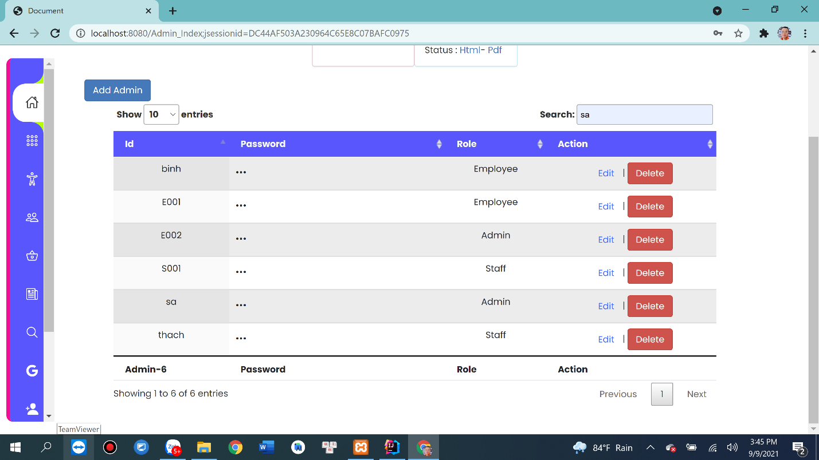
SCREEN SHOT GUIDE FOR EMPLOYEE AS ADMIN

Slide 32
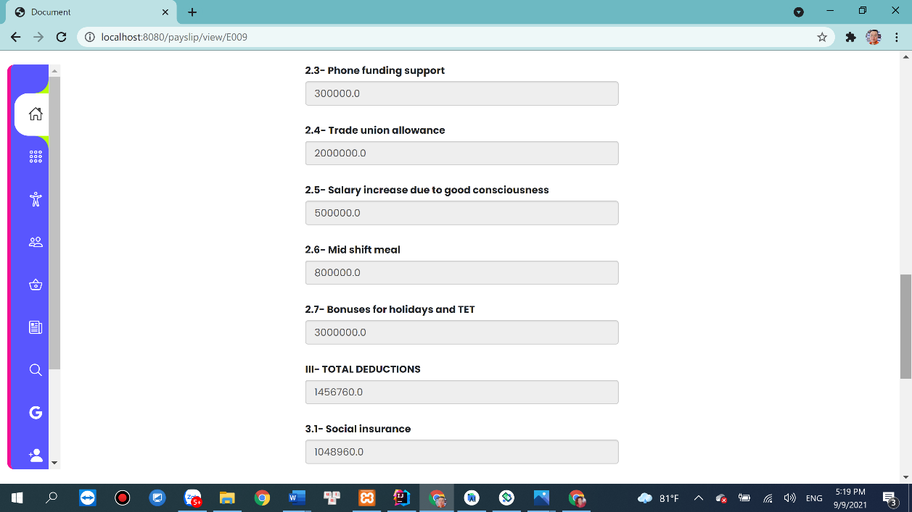
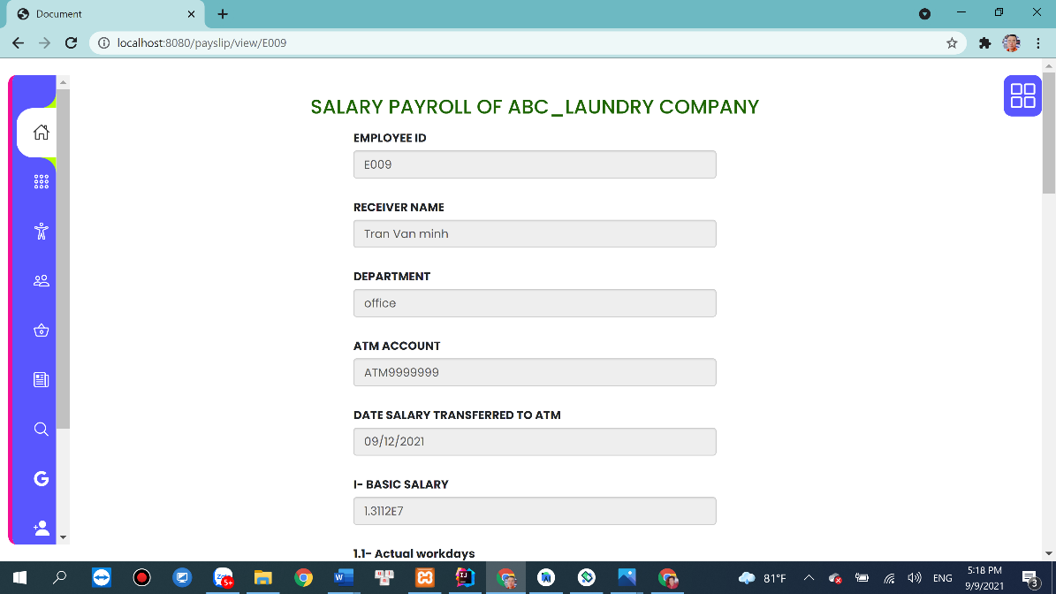
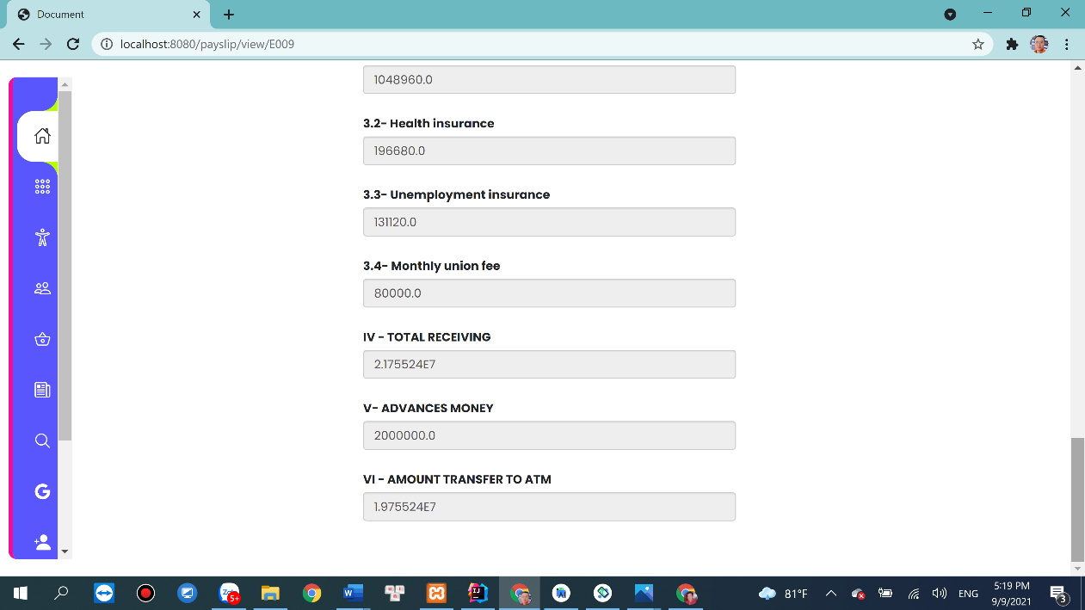
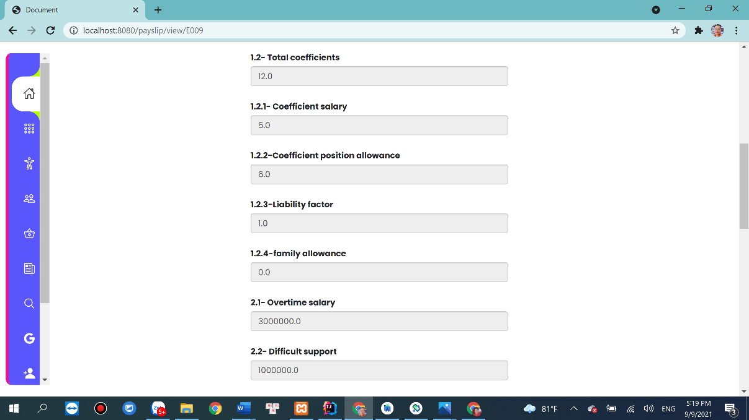
SCREEN SHOT PAYSLIP FOR EMPLOYEE

Slide 33
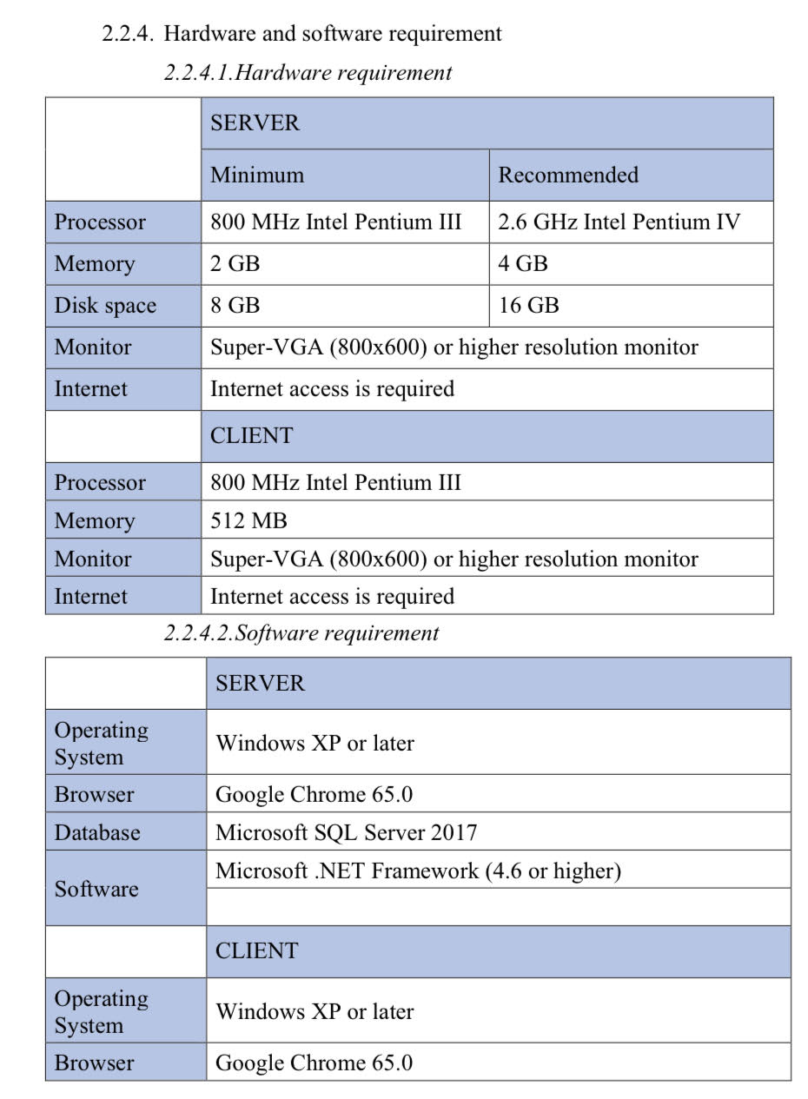
HARDWARE AND SOFTWARE REQUIREMENT FOR SERVER & CLIENT

Slide 34
THANK YOU FOR ATTENTION

